Slide 1

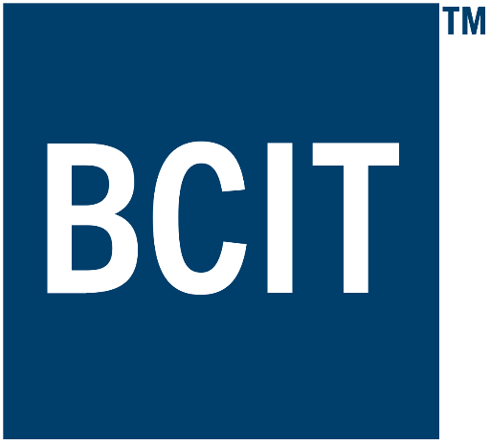
Applied Virtual Networks
COMP 4912
Instructor: Dawood Sajjadi
PhD, SMIEEE, CISSP
ssajjaditorshizi@bcit.ca
Winter-Spring 2025
Week #9

Slide 2
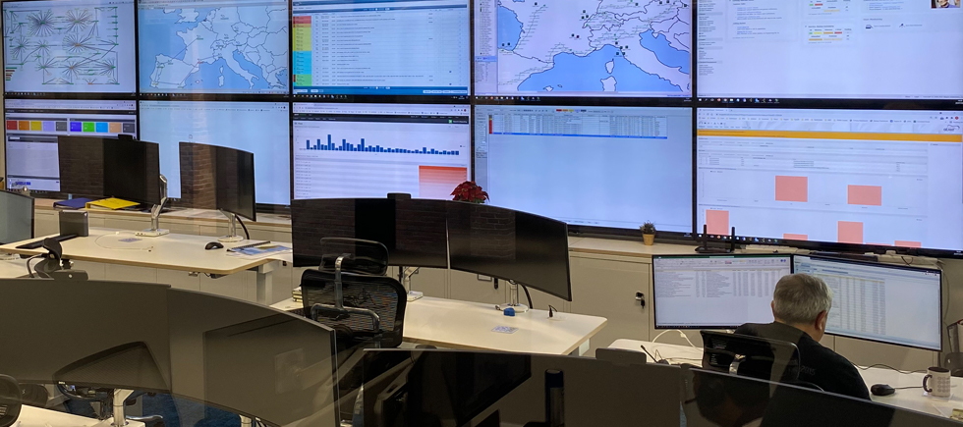
Monitoring an IT Infrastructure
RECAP
🛡 Ensure System Reliability – Detect and prevent failures before they impact operations.
📊 Performance Optimization – Identify bottlenecks and optimize resource utilization.
⚠ Early Threat Detection – Spot security vulnerabilities and respond to anomalies in real time.
💰 Cost Efficiency – Reduce downtime and optimize IT spending by identifying inefficiencies.
📉 Minimize Downtime – Proactive monitoring helps avoid costly service disruptions.
📜 Compliance & Auditing – Maintain logs and reports to meet regulatory requirements.
📈 Capacity Planning – Predict future growth and scale infrastructure accordingly.
🔍 Root Cause Analysis – Quickly identify and troubleshoot system issues.
Network
Operation
Center
Security
Operation
Center

Slide 3
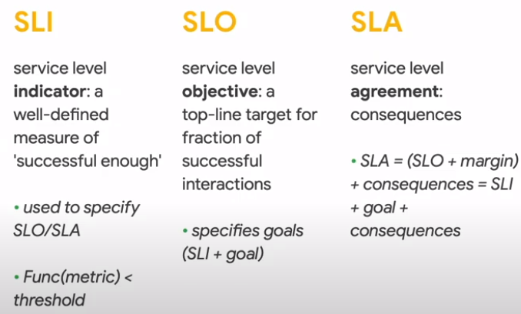
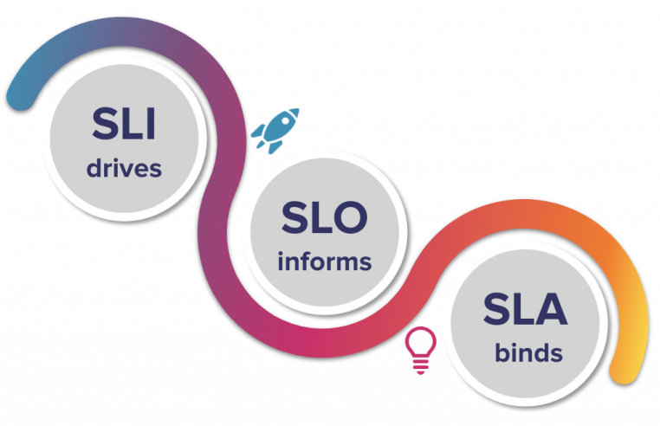
Metrics for Service Monitoring
RECAP
There are several known metrics that help to define service Reliability, Availability, and Disaster Recovery strategies.
SLO (Service Level Objective)
A targeted performance goal used internally by service teams.
Defines desired service levels (Latency < 100ms, or Uptime > 99.95%).
SLA (Service Level Agreement)
A formal contract between a service provider and a customer.
Defines minimum service guarantees (e.g., 99.99% uptime).
Includes penalties if the provider fails to meet commitments.
SLI: current measured API latency is 160ms
SLO: internal target latency < 150ms
SLA: guaranteed max latency to customer is < 170ms
There will be a penalty & legal action for breach of SLA

Slide 4

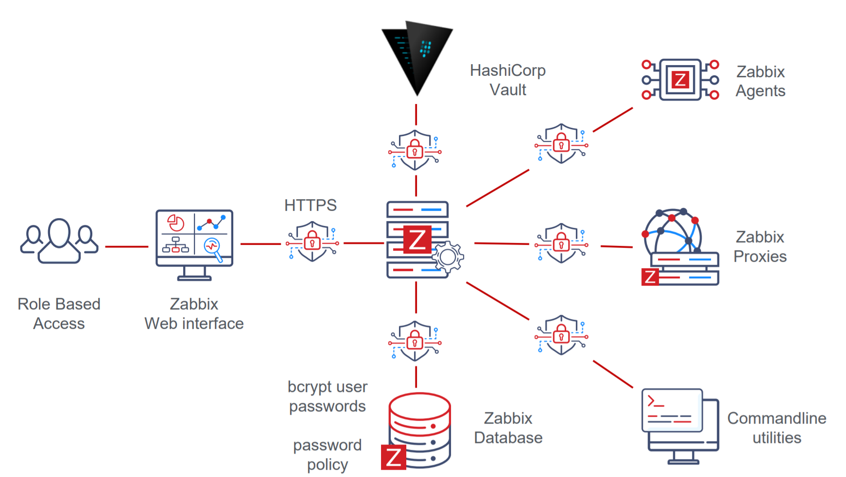
Monitoring an IT Infrastructure
RECAP
Zabbix Structure
https://www.zabbix.com

Slide 5
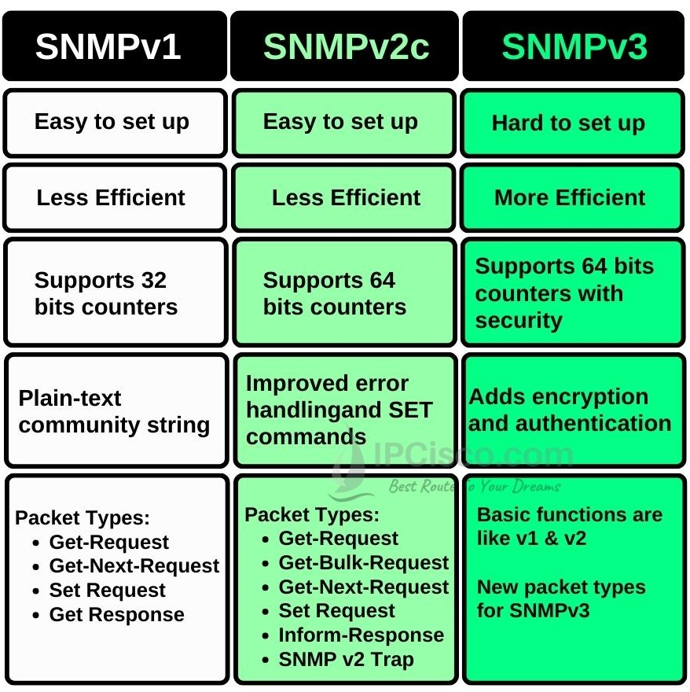
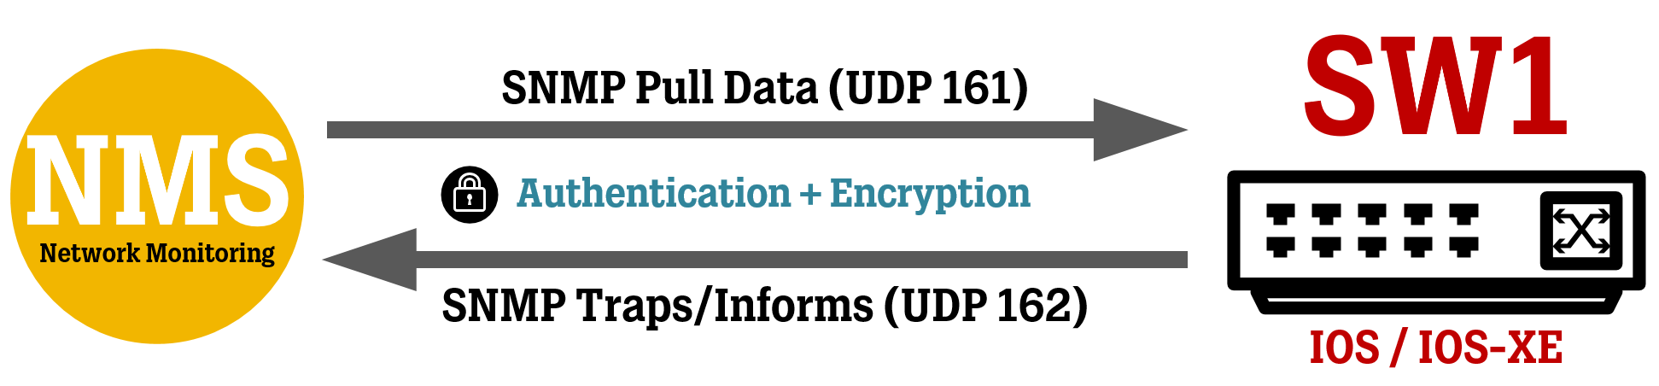
SNMP Versions
RECAP
SNMP comes in three versions: SNMPv1, SNMPv2c, and SNMPv3.
SNMPv3 is the most Secure version.
SNMPv1: Basic functionality, no security.
SNMPv2c: Improved performance, still uses community strings.
SNMPv3: Security enhancements (Authentication & Encryption).

Slide 6
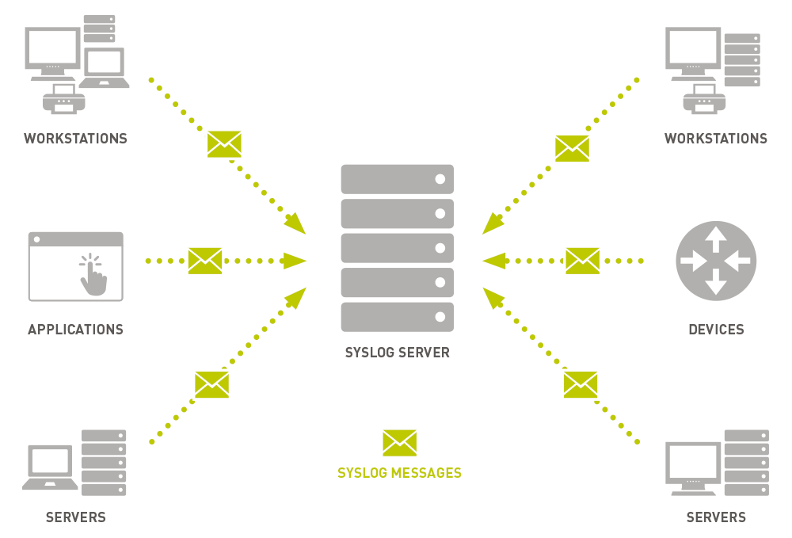
Syslog
RECAP
Syslog is a standard protocol for Logging System Messages.
It allows Applications and Systems to send logs to a Centralized Location.
Used for Monitoring, Troubleshooting, and Security analysis.
Components of Syslog
Log Generators – Applications/System processes that create logs.
Syslog Daemon - Manages log processing and forwarding .
Log Storage/Server - Collects and stores logs centrally for analysis.
Syslog Message Format
Priority (PRI) - Severity and facility level.
Timestamp - When the log was generated.
Hostname - The system that sent the log.
Application name - Source of the message.
Message Content - The actual log details.
<34> Mar 8 10:15:22 myserver sshd[1234]: Failed login attempt

Slide 7
Learning Outcomes of Week #9
Understand the core concepts of Disaster Recovery (DR).
Exploring different options to provide Redundancy for Internet services.
Delineating Hardware/Software requirements for having High Availability.
Understanding Business Continuity and RPO/RTO/RSL concepts.
Describing Backup technologies and mechanisms.
Explaining roles of LB/Network protocols in providing service availability.

Slide 8
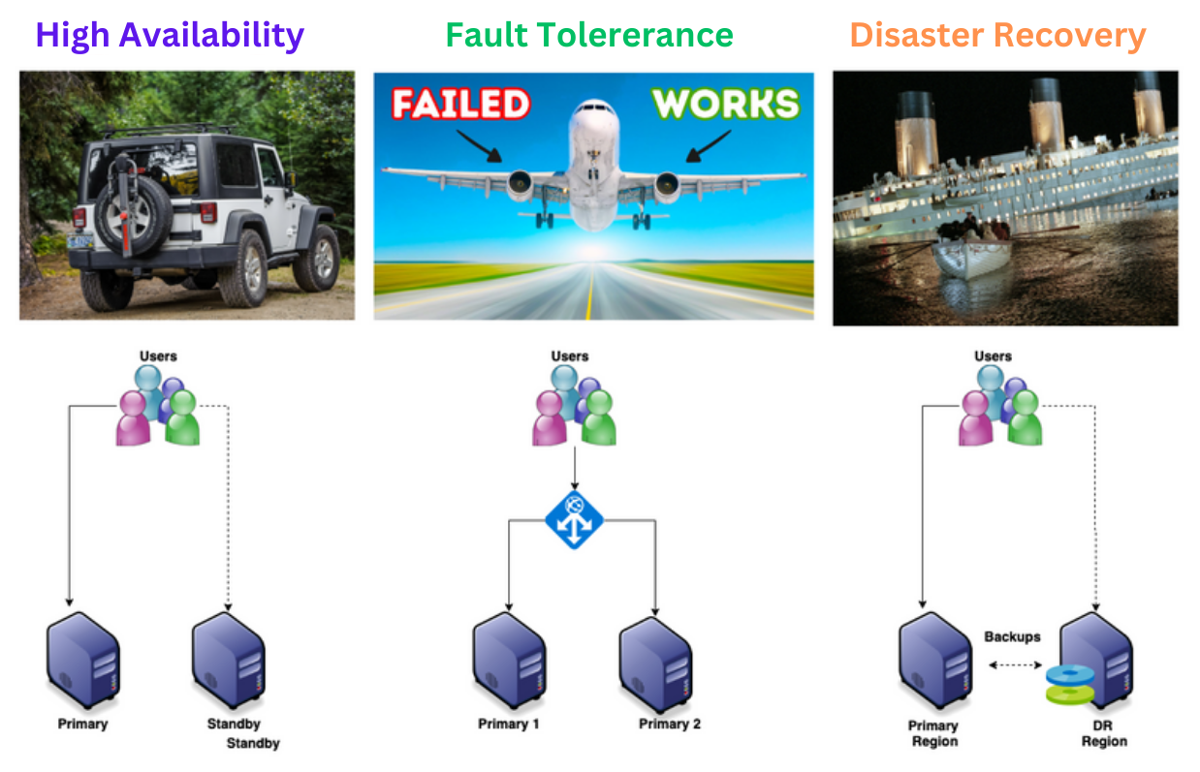
HA vs. FT vs. DR
Notes:
High Availability does not mean that the systems will not have failure and downtime. An Highly Available system can have downtime but the systems should be designed to be up and running with minimal efforts in case of a failure.
A Fault-Tolerant Design enables a system to continue its intended operation, possibly at a reduced level, rather than failing completely, when some part of the system fails
Disaster Recovery assumes that the primary site is not recoverable (at least for some time) and represents a process of restoring data and services to a secondary survived site

Slide 9
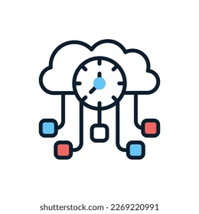
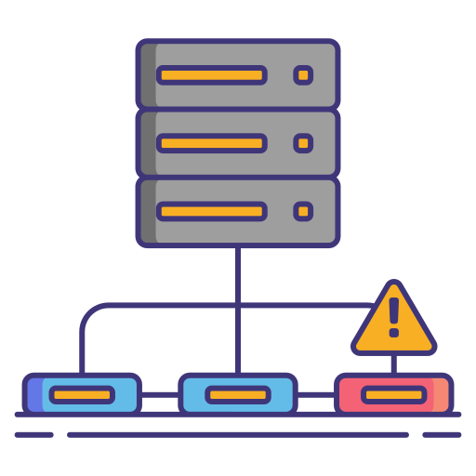
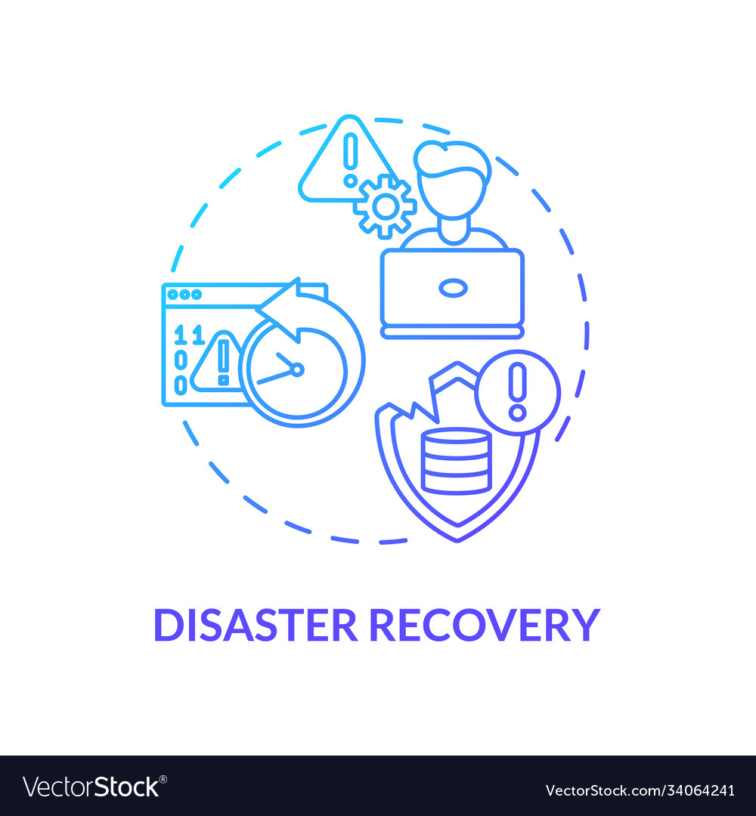
HA vs. FT vs. DR
What is High Availability (HA)?
It is defined as a characteristic of a system which aims to ensure an agreed level of operational performance, usually Uptime, for a higher than normal period. High Availability does not mean that the systems will not have failure and downtime. An Highly Available system can have downtime but the systems should be designed to be up and running with minimal efforts in case of a failure. These efforts can be manual or automated.
What is Fault Tolerance (FT)?
It is the property that enables a system to continue operating properly in the event of the failure of one or more faults within some of its components. A Fault-Tolerant Design enables a system to continue its intended operation, possibly at a reduced level, rather than failing completely, when some part of the system fails.
What is Disaster Recovery (DR)?
It is a set of policies, tools and procedures to enable the recovery or continuation of vital technology infrastructure and systems following a natural or human-induced disaster. Disaster Recovery assumes that the primary site is not recoverable (at least for some time) and represents a process of restoring data and services to a secondary survived site, which is opposite to the process of restoring back to its original place.

Slide 10
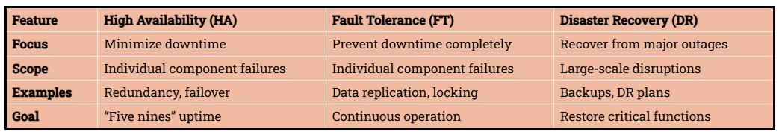
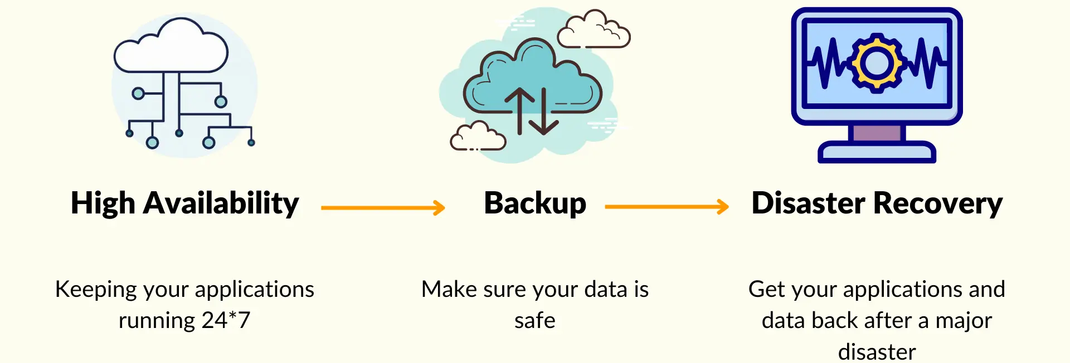
HA vs. FT vs. DR

Slide 11
Types of Redundancy
Hardware Redundancy: Duplicate physical components (e.g., servers, storage, network, power).
Software Redundancy: Clustering and failover mechanisms.
Network Redundancy: Practice of implementing backup links/devices to ensure continuous network availability.
Geographic Redundancy: Multiple sites/data centers across geographical regions.
Category | Technology | Purpose | Common Use Cases
Network | HSRP/VRRP | Router failover for uninterrupted gateway connectivity | Enterprise gateway redundancy
Network | BGP Multi-Homing | Using multiple ISPs for internet redundancy | Cloud providers, ISPs, large enterprises
Network | SD-WAN | Dynamic WAN failover across multiple connections | Hybrid cloud, remote offices
Server | Failover Clustering | Automatic failover between clustered servers | Databases, file servers, enterprise apps
Server | Virtualization HA | Ensures VM continuity if a host fails | VMware HA, Hyper-V, Proxmox
Server | Database Replication | Replicates database data across multiple servers | SQL & NoSQL databases
Application | Load Balancers | Distributes traffic to multiple application servers | Web applications, microservices
Application | Kubernetes Auto-Healing | Automatically restarts failed containers | Cloud-native applications
Application | Multi-Region Deployment | Deploys services in multiple geographic locations for DR | Disaster recovery, content delivery
Hardware | Redundant Power Supply (PSU) | Prevents power failures by having dual power inputs | Enterprise data centers
Hardware | Power Distribution Units (PDU) | Distributes electrical load and prevents failures | Server racks, Power management
Hardware | RAID Storage | Protects against disk failures in storage systems | Storage arrays, cloud storage

Slide 12
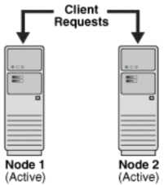
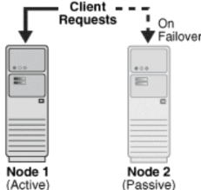

Core HA Concepts
Identify Single Points of Failure.
Add Redundancy to eliminate Failures.
Need Policy for how to interface with Redundant Systems.
Active/Active:
Both redundant components used in normal operation; symmetric design.
Higher utilization and capacity/performance
Capacity/performance is reduced on failure
Active/Passive (Primary/Secondary):
A Primary and Secondary system; secondary only does work if primary fails; asymmetric design.
Failures don’t affect capacity/performance
Half the hardware is idle most of its life (low utilization)
Imagine an Active/Passive system.
What if the two redundant systems lose contact with each other, and each thinks its time to “take over”?
Both are serving traffic and issuing commands, which lead to chaos!
Redundant computer systems must have protocol to govern takeover.
https://people.duke.edu/~tkb13/courses/ece566-2020fa/slides/09-ha.pdf

Slide 13
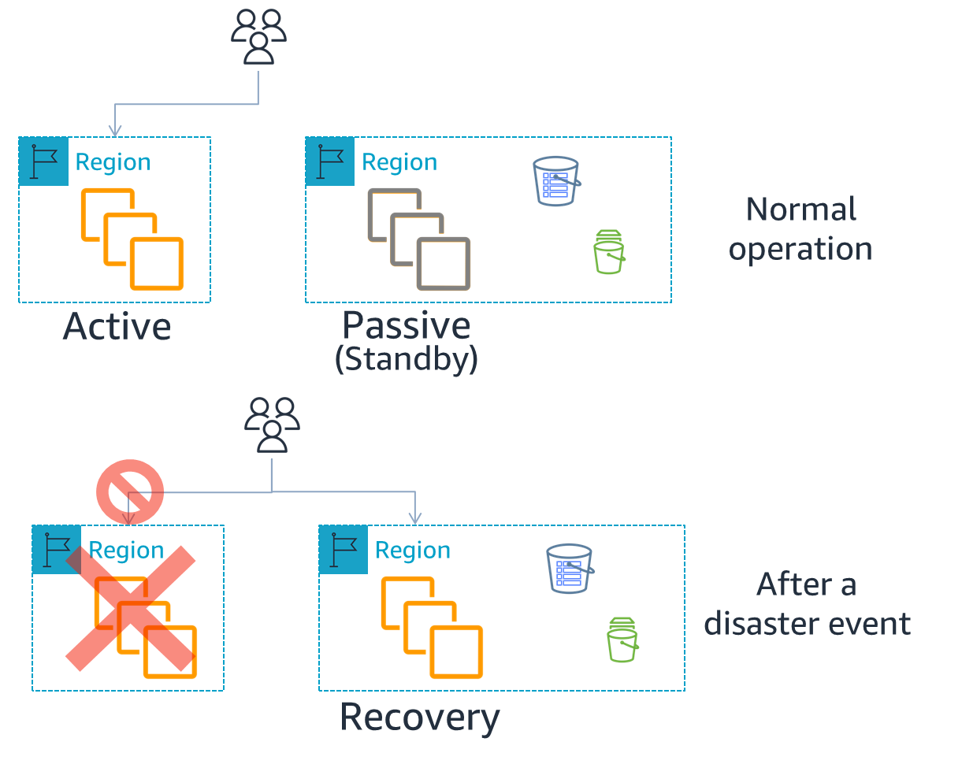
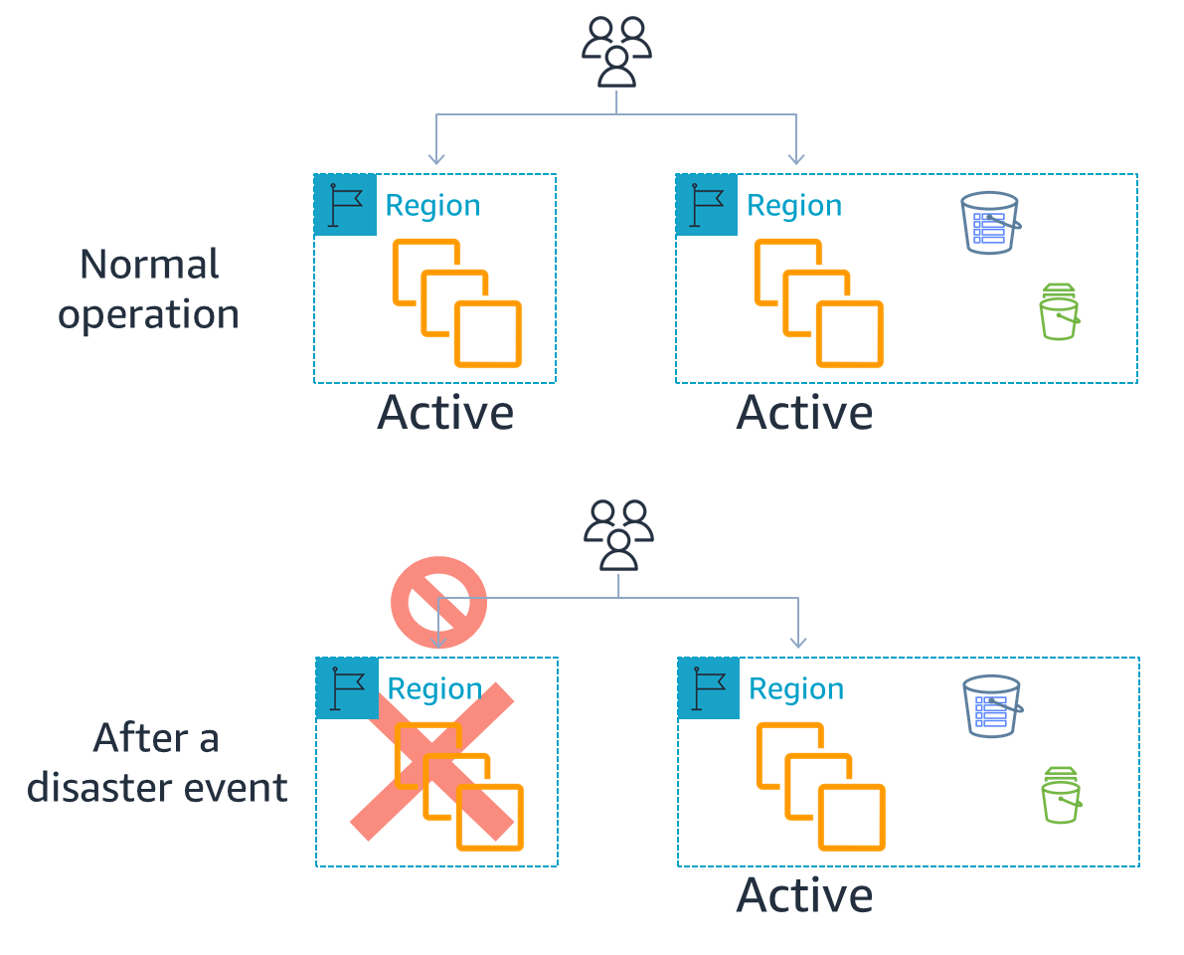
Active/Active & Active/Passive DR Strategies
https://aws.amazon.com/blogs/architecture/disaster-recovery-dr-architecture-on-aws-part-i-strategies-for-recovery-in-the-cloud/

Slide 14
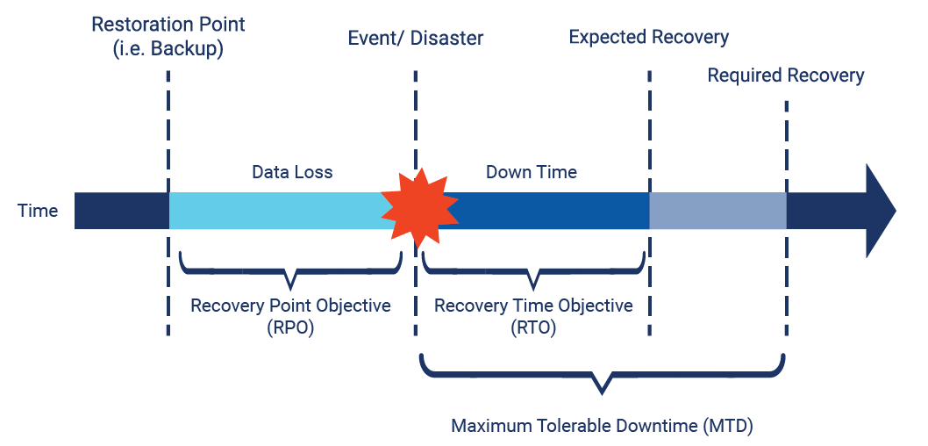
Metrics for Service Monitoring
There are several known metrics that help to define service Reliability, Availability, and Disaster Recovery strategies.
SLO (Service Level Objective)
A targeted performance goal used internally by service teams.
Defines desired service levels (Latency < 100ms, or Uptime > 99.95%).
SLA (Service Level Agreement)
A formal contract between a service provider and a customer.
Defines minimum service guarantees (e.g., 99.99% uptime).
Includes penalties if the provider fails to meet commitments.
RPO (Recovery Point Objective)
Maximum amount of data loss a company can tolerate.
RTO (Recovery Time Objective)
Maximum time allowed to restore operations after a disruption.
RSL (Recovery Service Level)
The percentage of a service that must be available during a disaster.

Slide 15
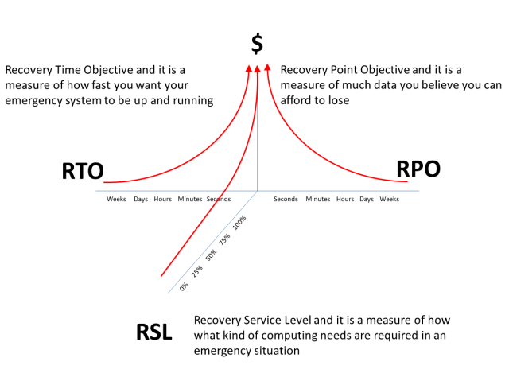
RPO/RTO/RSL vs. Cost
Sample Values for Selected Services
Service | RPO (hour) | RTO (hour) | RSL (%)
LDAP | 15 minutes | 1 hour | 99.90%
DNS | 5 minutes | 30 minutes | 99.99%
Email | 30 minutes | 2 hours | 99.50%
Database | 10 minutes | 1 hour | 99.95%
File Server | 1 hour | 3 hours | 99%
Web Server | 10 minutes | 45 minutes | 99.90%

Slide 16
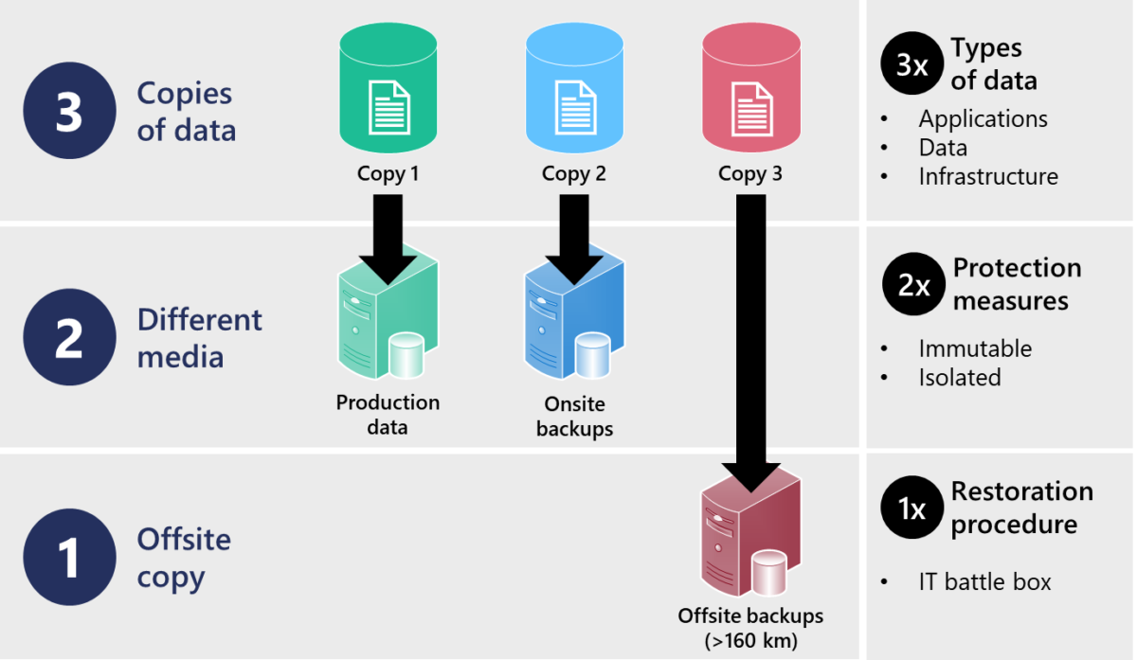
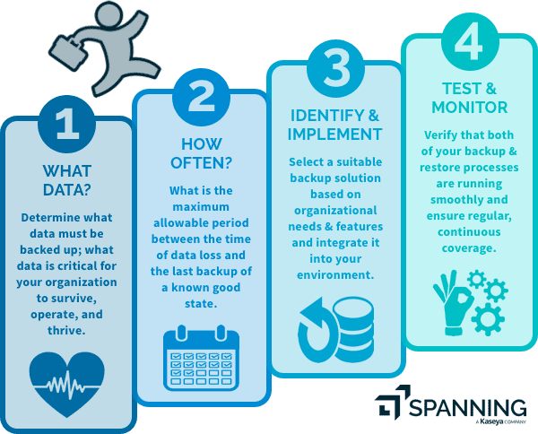
Backup Strategies
3-2-1 Backup Rule

Slide 17
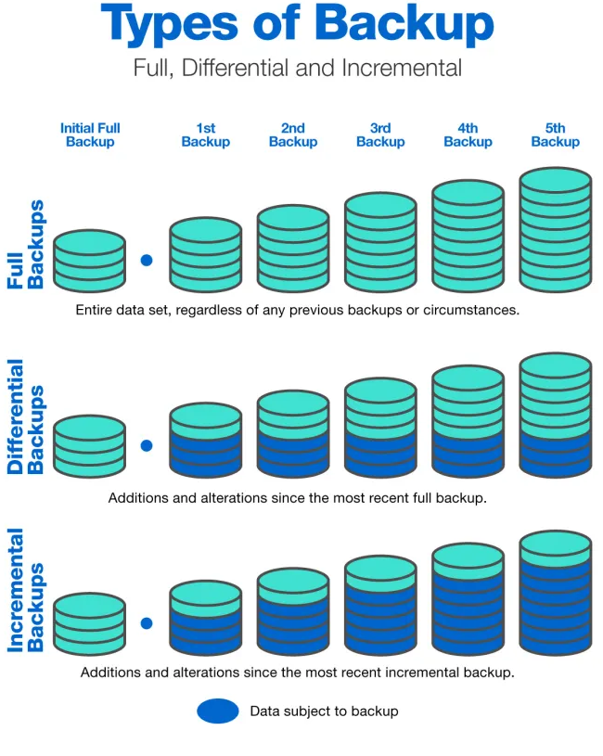
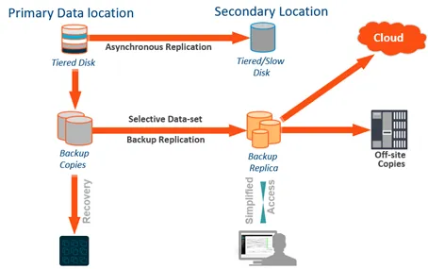
Backup Types
https://blog.quest.com/7-steps-for-creating-a-data-backup-strategy/
https://www.exabytes.my/blog/compare-incremental-full-differential-backup/
Notes:
A full backup copies all selected data, requiring the most storage and time but providing the fastest recovery. Incremental backups only store changes since the last backup (full or incremental), using less space but requiring multiple backups for restoration, whereas differential backups save changes since the last full backup, growing larger over time but allowing faster recovery than incremental backups.

Slide 18
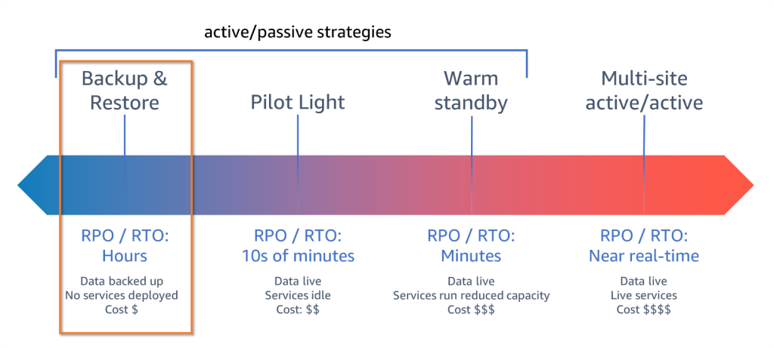
RPO/RTO/RSL vs. Cost
https://aws.amazon.com/blogs/architecture/disaster-recovery-dr-architecture-on-aws-part-i-strategies-for-recovery-in-the-cloud/
Notes:
In the context of Disaster Recovery (DR), a "pilot light" environment refers to a minimal, cost-effective version of your IT infrastructure running in the cloud, ready to be quickly scaled up to full capacity in case of a disaster, ensuring minimal downtime and data loss.
Warm standby means having a scaled-down, yet fully functional, copy of your production environment in another region, ready to quickly scale up and handle traffic in case of a disaster, offering a faster recovery time than a cold standby but at a higher cost.
Multi-site active/active means running your workload simultaneously in multiple locations (regions or data centers) with all sites handling production traffic and data replication, ensuring minimal downtime and data loss during a disaster.

Slide 19
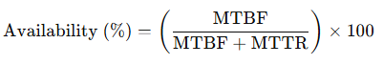
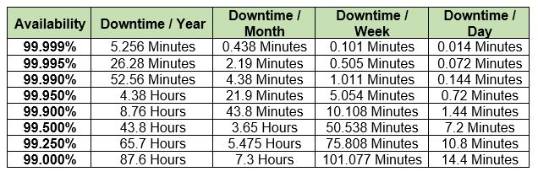
Five-Nine SLA (99.999%)
MTBF (Mean Time Between Failures)
The average time a system runs before experiencing a failure.
A higher MTBF means fewer failures, increasing overall uptime.
Example: If a server has an MTBF of 200,000 hours, it fails less frequently.
Higher MTBF → Fewer failures → Better uptime
Lower MTTR → Faster recovery → Better uptime
MTTR (Mean Time To Repair)
The average time taken to repair and restore service after a failure.
A lower MTTR reduces downtime, improving availability.
Example: If an incident occurs and the service is restored in 5 minutes, it helps maintain high uptime.
5 nine
4 nine
3 nine
2 nine
https://aws.amazon.com/blogs/publicsector/achieving-five-nines-cloud-justice-public-safety/

Slide 20
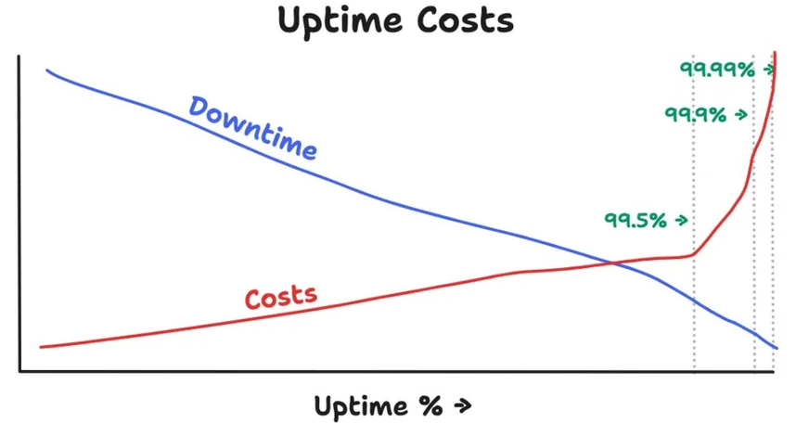
Five-Nine SLA
Cost $
5 nine
4 nine
3 nine
2 nine
https://aws.amazon.com/blogs/publicsector/achieving-five-nines-cloud-justice-public-safety/

Slide 21

Data Centers, Engines of the Internet
Let’s Watch https://www.youtube.com/watch?v=80aK2_iwMOs

Slide 22
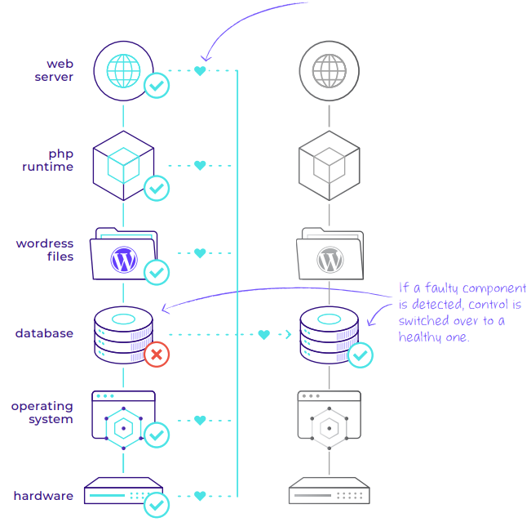
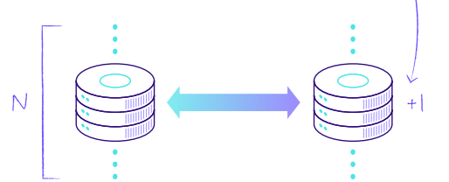
Different Layers to Apply Redundancy
For every component, there is always one extra.
This is called N+1 redundancy.

Slide 23
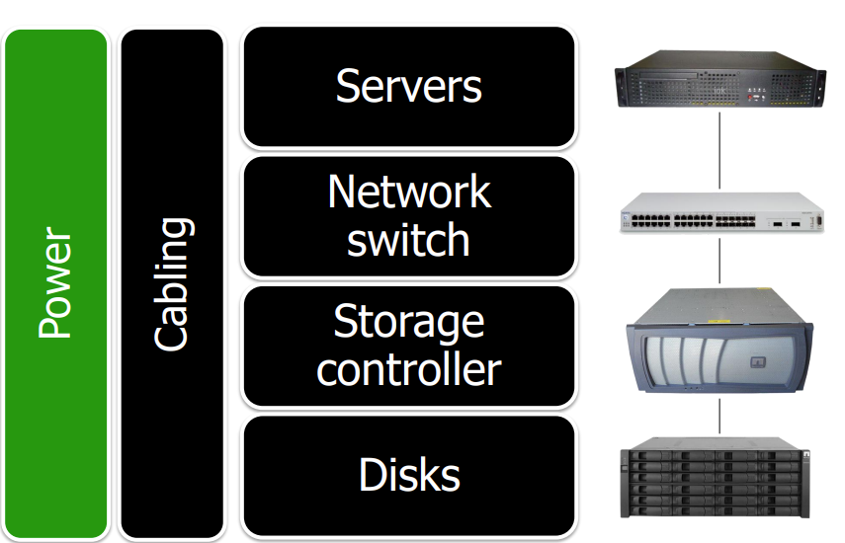
Different Layers to Apply Redundancy
https://people.duke.edu/~tkb13/courses/ece566-2020fa/slides/09-ha.pdf

Slide 24
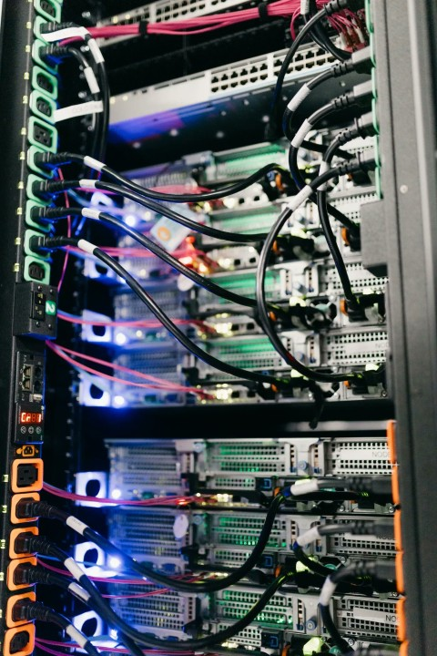
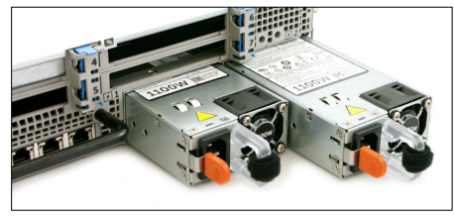
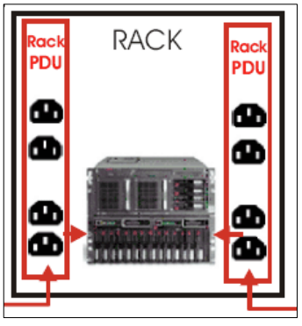
Hardware Redundancy (Power)
Everything has 2+ power supplies
Equipment can survive with half its power supplies dead
This protects against power supply failure
Power comes from Power Distribution Units (PDUs), rackmount power bars
HA power: Racks have two PDUs
PDU 1 hooked to “left” power supply
PDU 2 hooked to “right” power supply
Power supplies usually hot-swappable (replaceable without downtime)
https://people.duke.edu/~tkb13/courses/ece566-2020fa/slides/09-ha.pdf

Slide 25
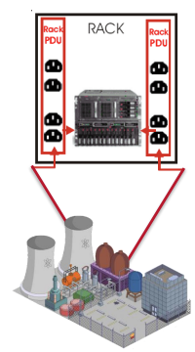
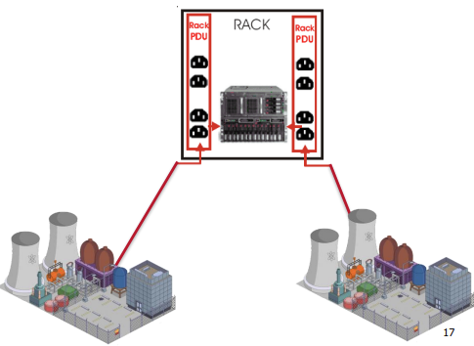
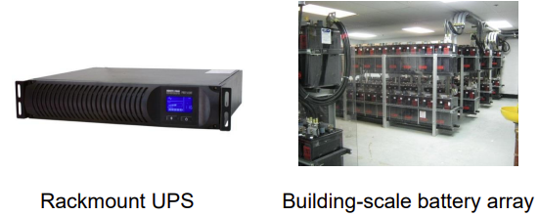
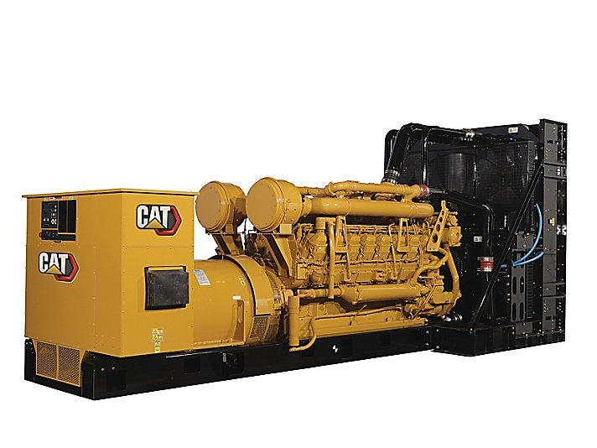
Hardware Redundancy (Power)
UPS: Uninterruptable Power Supply
Utility Power (Single/Double Feed)
Takes AC power in, gives AC power out.
Keeps a big battery array charged.
If AC power-in fails, AC power-out comes from battery (w/o interruption).
DC power from batteries must be converted to AC with an inverter.
Keep things running long enough to start a gasoline/diesel generator.
If not, keep things running, long enough for graceful shutdown.
https://people.duke.edu/~tkb13/courses/ece566-2020fa/slides/09-ha.pdf
Diesel Generator

Slide 26
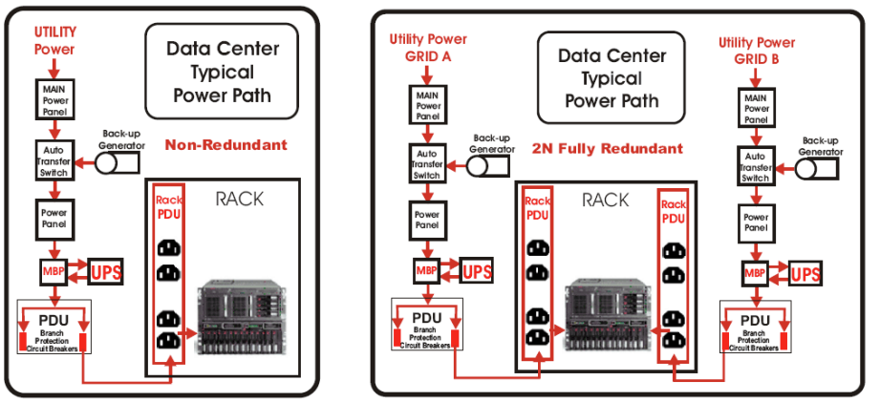
Hardware Redundancy (Power)
https://people.duke.edu/~tkb13/courses/ece566-2020fa/slides/09-ha.pdf

Slide 27
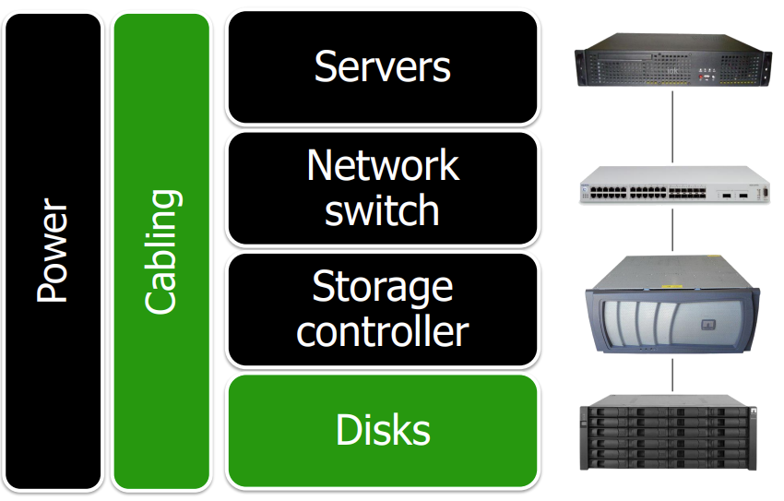
Different Layers to Apply Redundancy
https://people.duke.edu/~tkb13/courses/ece566-2020fa/slides/09-ha.pdf

Slide 28
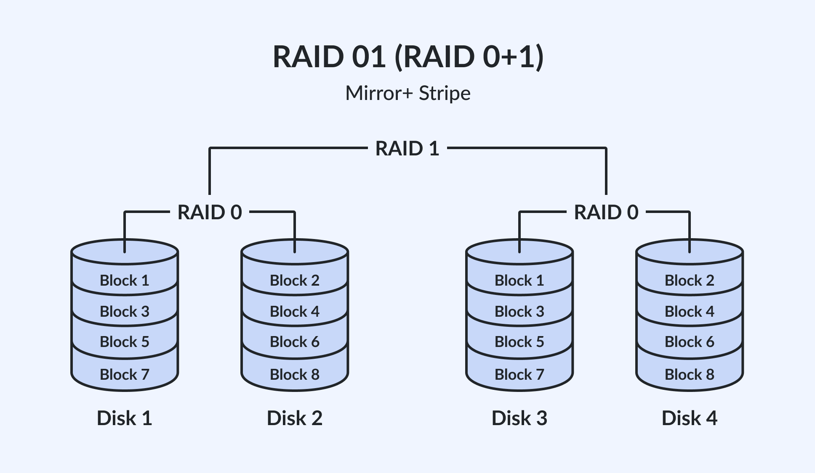
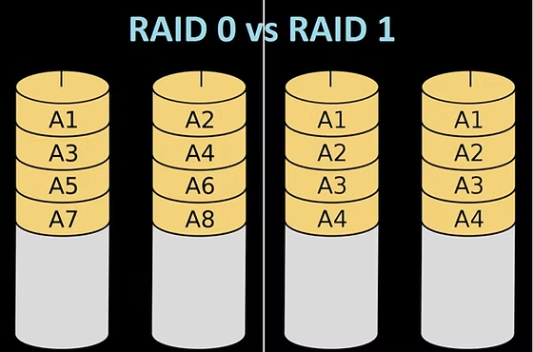
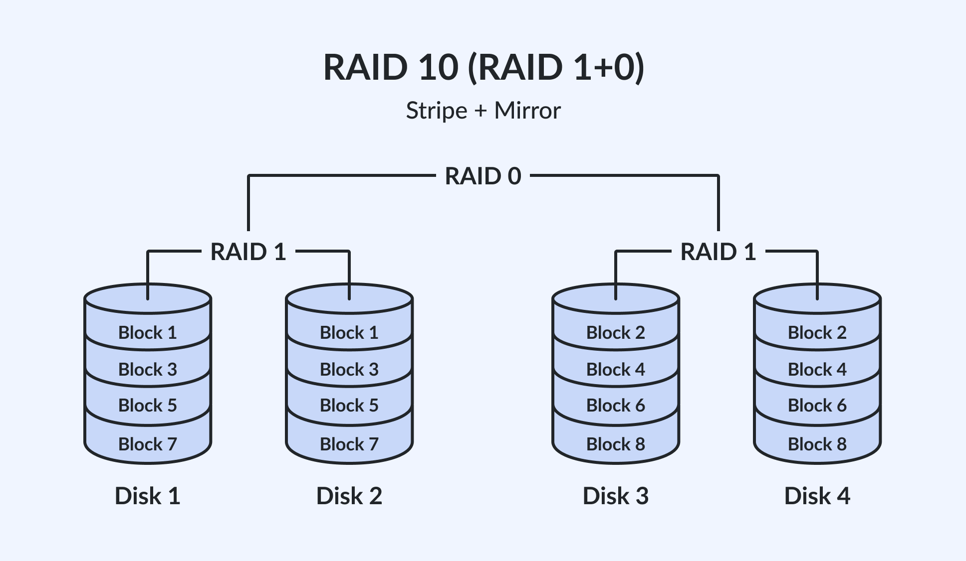
Hardware Redundancy (Disks)
https://people.duke.edu/~tkb13/courses/ece566-2020fa/slides/09-ha.pdf

Slide 29
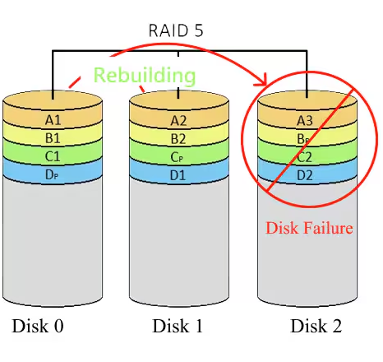
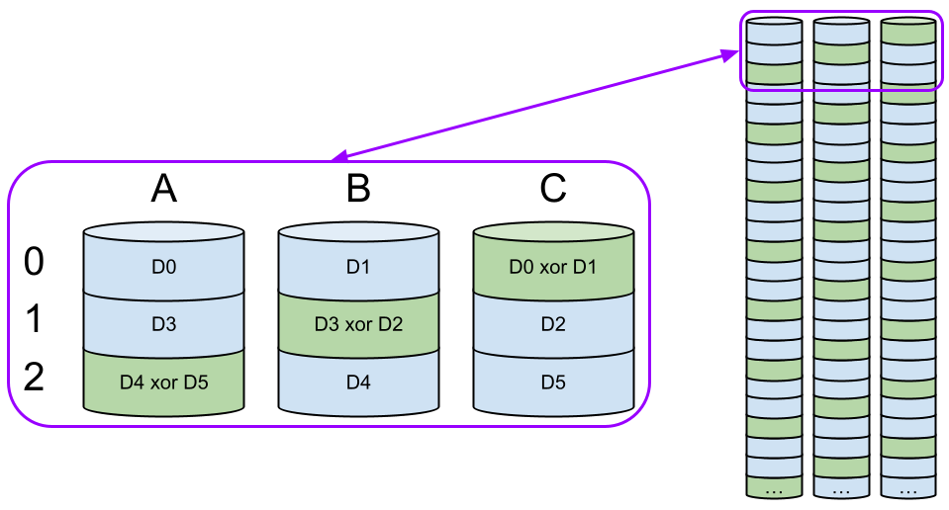
Hardware Redundancy (Disks)
https://people.duke.edu/~tkb13/courses/ece566-2020fa/slides/09-ha.pdf

Slide 30
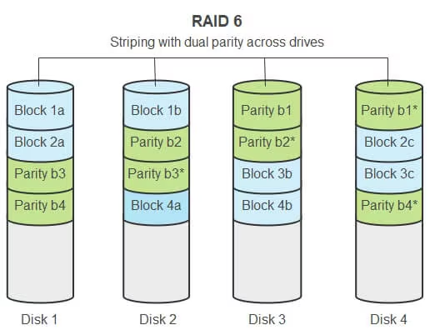
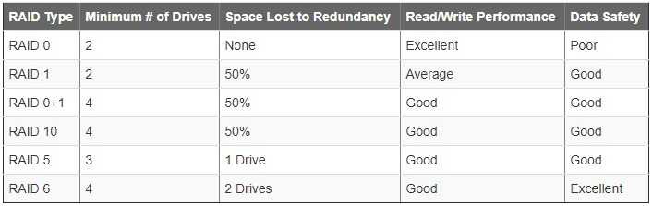
Hardware Redundancy (Disks)
RAID 5
uses a single parity stripe, which is distributed across all disks.
Needs at least 3 disks, and can tolerate only 1 disk failure.
RAID 6
uses two parity stripes, distributed across all disks, offers greater fault-tolerance.
Needs at least 4 disks, and can tolerate up to 2 disks failure.
https://www.pugetsystems.com/labs/articles/raid-explained-24/

Slide 31
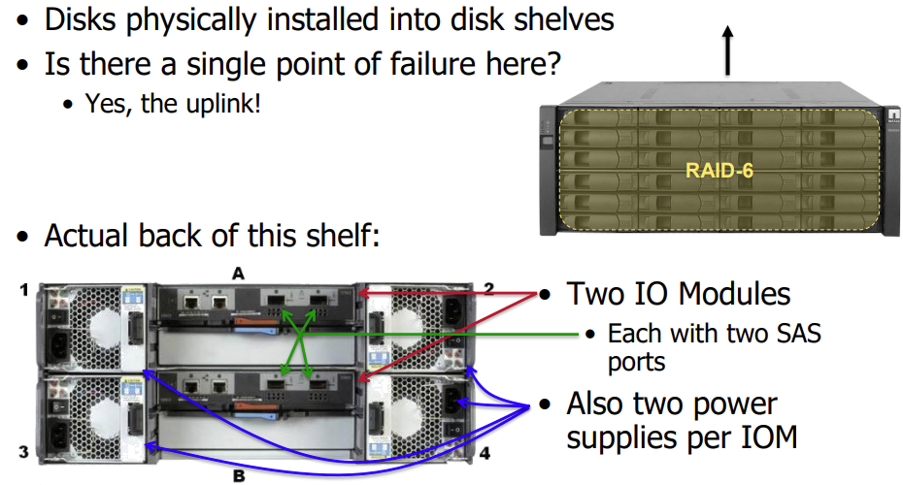
Hardware Redundancy (Disks)
https://people.duke.edu/~tkb13/courses/ece566-2020fa/slides/09-ha.pdf

Slide 32
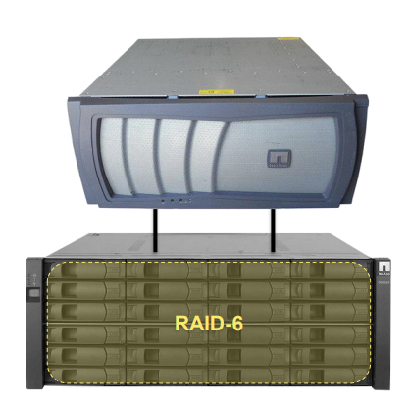
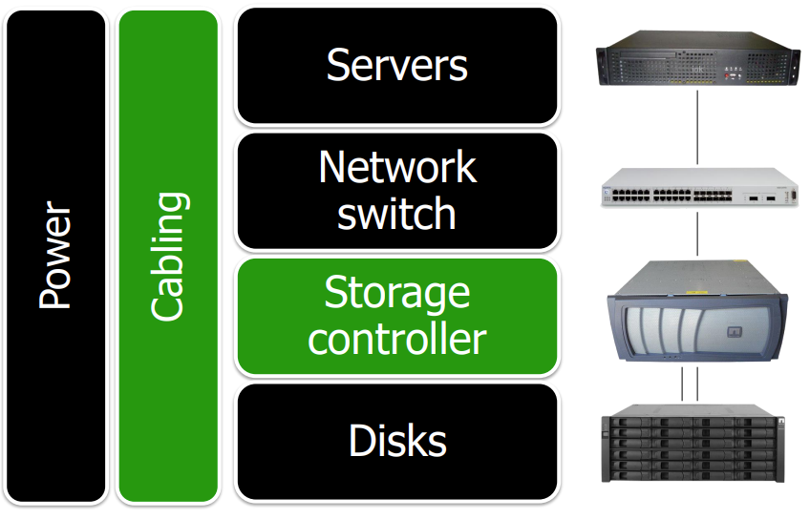
Hardware Redundancy (Disks)
Controller Module
Can be Single Point of Failure
Storage
https://people.duke.edu/~tkb13/courses/ece566-2020fa/slides/09-ha.pdf

Slide 33

Hardware Redundancy (Disks)
https://people.duke.edu/~tkb13/courses/ece566-2020fa/slides/09-ha.pdf
Notes:
Could use this to be active/passive:
• All disks are “owned” by controller A
• All storage is provisioned on controller A
• If controller A goes down, controller B can “take over” and basically impersonate controller A without missing a beat
Could use this to be active/active:
• Half disks are “owned” by controller A, half by controller B
• Provision workloads on each controller
• If controller A goes down, controller B is responsible for both its own usual workload as well as controller A’s
In either case, when situation is resolved:
• Controller B can “give back” to controller A the work it took over
• This restores HA capability after a failure

Slide 34

Network Redundancy
https://people.duke.edu/~tkb13/courses/ece566-2020fa/slides/09-ha.pdf

Slide 35

Network Redundancy
https://people.duke.edu/~tkb13/courses/ece566-2020fa/slides/09-ha.pdf

Slide 36

Network Redundancy
https://people.duke.edu/~tkb13/courses/ece566-2020fa/slides/09-ha.pdf

Slide 37

Network Redundancy
https://www.networkdefenseblog.com/post/network-design-network-edge

Slide 38


Network Redundancy
https://www.cisco.com/c/en/us/td/docs/solutions/Enterprise/Data_Center/DC_Infra2_5/DCI_SRND_2_5a_book/DCInfra_2a.html

Slide 39

Complete Redundancy
https://people.duke.edu/~tkb13/courses/ece566-2020fa/slides/09-ha.pdf

Slide 40


Service Load Balancing
Notes:
In the IP hash method, the load balancer performs a mathematical computation, called hashing, on the client IP address. It converts the client IP address to a number, which is then mapped to individual servers.

Slide 41

Service Load Balancing
Notes:
In the IP hash method, the load balancer performs a mathematical computation, called hashing, on the client IP address. It converts the client IP address to a number, which is then mapped to individual servers.

Slide 42

App/DB HA in AWS
https://aws.amazon.com/blogs/database/deploy-amazon-rds-on-aws-outposts-with-multi-az-high-availability/

Slide 43



VM Replication
VM Replication creates an exact, synchronized copy (replica) of a virtual machine (VM) on a secondary host or storage, ensuring rapid recovery in case of disaster or downtime.

Slide 44

AWS DR
https://aws.amazon.com/blogs/architecture/disaster-recovery-dr-architecture-on-aws-part-i-strategies-for-recovery-in-the-cloud/

Slide 45




DR Summary
https://medium.com/@maheshsaini.sec/system-design-4-top-cloud-disaster-recovery-strategies-e91750d6c93d

Slide 46


End of Lecture #9
Deadline for Assignment #5
March 21st, 2025
THANK Y☺U
- Dawood Sajjadi

